Slide 1
Photo Booth Rental Brea
https://sites.google.com/view/brea-photo-booth-rental/home
Notes:
https://sites.google.com/view/brea-photo-booth-rental/home
https://drive.google.com/drive/folders/1CNlstsJzmPRpGDygZTjkJsPljmPP7HR7?usp=sharing
https://news.google.com/rss/search?q=photobooth+rental
https://drive.google.com/drive/folders/1THol6KdyQ5eRHDkuSNzpCCuA7W6G_06a?usp=sharing
https://drive.google.com/drive/folders/1qNjs32GLDqs_gyV7wvfqwQ0J0IbU7Eji?usp=sharing
https://drive.google.com/drive/folders/1LtInV3kl1GuLrtGtrQ7Gmty0iUOiqrW8?usp=sharing
https://drive.google.com/drive/folders/1nj2zzhbqP7alffxAB792eiMxJqQL9zRj?usp=sharing
https://drive.google.com/file/d/1M5yH2tZnwNNm8ymEjI8_SSZpgZtHNOAC/view?usp=sharing
https://drive.google.com/file/d/1wwDiQp1j2AiEPnUBtX86PsdkBuzqd4U7/view?usp=sharing
https://drive.google.com/file/d/1rjpPFpq1KLwNRQI5zUqq3p8Fb46TxuWh/view?usp=sharing
https://docs.google.com/spreadsheets/d/1eQSc2xaL9KH78-tqdSppxuOhVxSgCLxnUHtppYlS5V8/edit?usp=sharing
https://docs.google.com/spreadsheet/pub?key=1eQSc2xaL9KH78-tqdSppxuOhVxSgCLxnUHtppYlS5V8
https://docs.google.com/spreadsheets/d/1eQSc2xaL9KH78-tqdSppxuOhVxSgCLxnUHtppYlS5V8/pubhtml
https://docs.google.com/spreadsheets/d/1eQSc2xaL9KH78-tqdSppxuOhVxSgCLxnUHtppYlS5V8/pub
https://docs.google.com/spreadsheets/d/1eQSc2xaL9KH78-tqdSppxuOhVxSgCLxnUHtppYlS5V8/view
https://docs.google.com/forms/d/1v-Z3t2Yx3XfHh8V7DWZTwv99Di5dsjP59RcFFN8b8Ao/edit?usp=sharing
https://docs.google.com/drawings/d/1dNEp74shof81iozfyKaPZ8nPRPjle76vxNq3C4vsdTw/edit?usp=sharing
https://drive.google.com/file/d/1GYmOSOlo4yQ_pS_0YEV3H-FwZ_N3dFKh/view?usp=drivesdk
https://sites.google.com/view/culver-city-video-booth-rental/home
https://docs.google.com/document/d/1NLkSNiSEam89U1lib2N5PgHvaIfz8GTBImJ2aPJXoB4/edit?usp=sharing
https://docs.google.com/document/d/1NLkSNiSEam89U1lib2N5PgHvaIfz8GTBImJ2aPJXoB4/pub
https://docs.google.com/document/d/1NLkSNiSEam89U1lib2N5PgHvaIfz8GTBImJ2aPJXoB4/view
https://docs.google.com/presentation/d/1WXCmFum3W5g6BYVWYwcicoNxeAq5DHnEomLNUNiEm9g/edit?usp=sharing
https://docs.google.com/presentation/d/1WXCmFum3W5g6BYVWYwcicoNxeAq5DHnEomLNUNiEm9g/pub?start=true&loop=true&delayms=3000
https://docs.google.com/presentation/d/1WXCmFum3W5g6BYVWYwcicoNxeAq5DHnEomLNUNiEm9g/view
https://docs.google.com/presentation/d/1WXCmFum3W5g6BYVWYwcicoNxeAq5DHnEomLNUNiEm9g/htmlpresent

Slide 2


Slide 3


Slide 4
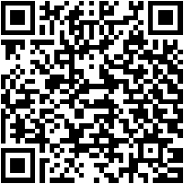
Photo Booth Rental Brea
upgrade your issue next the unbelievable Vogue booth rental from fortunate Frog Photo Booth.Our Vogue booth produces distinctive photo booth content, much next the open tunnel setup used by supermodels in Vogue magazine. Our Vogue booth creates a unique video experience by filming videos in a tunnel of sporadic lights! After it is finished, everyone in the booth may text or email the enormously branded video to themselves directly from the kiosk and say it to social media using their phones. If you want a video experience that inspires people to share your branded content on social media and a unique experience they haven't had before.Both of those criteria are met by the Vogue Booth, but the publicize in addition to has a significant impact. Our other Vogue Booth Rental from lucky Frog can only be described as spectacular! It resembles a private catwalk landing field with opulent LED lights subsequent to a fashion magazine event!The Vogue Booth's endless vivacious law and radiant LED fresh panels swell to produce a endearing video clip that makes the ideal background for up to standard photo booth pics, GIFs, boomerangs, and videos. The Vogue Booth's booming LED background can be complemented by the excellent photo booth kiosk past tall quality lighting.The Vogue Booth is visually astonishing and creates incredible content that's perfect for sharing. To ensure that your memories are transformed into a cumulative new photo experience, rent our avant-garde Vogue booth. Your party should be unique and our protester Vogue booth will extremely transform your event.To create your concern even more remarkable, lucky Frog Photo Booth's incredible Vogue Booth Rentals pay for both video booths and Vogue Booths to every of orangey County. For more than a decade, fortunate Frog Photo Booth has captured several situation types including tall stop weddings, private events, birthday parties, bar mitzvahs, bat mitzvahs, proms, corporate events, and more.Step inside this impressive light-tunnel Vogue booth rental from lucky Frog Photo Booth and create fun photos, boomerang videos, GIFs or a print out. The light-tunnel Vogue booth rental from lucky Frog Photo Booth Photo features vibes Printouts GIFs, social sharing of your images, social network sharing, and tons of fun are all nearby from Vogue Booth. Because the thing is for that reason important, why not rent our light-tunnel Vogue booth rental from fortunate Frog Photo Booth?We provide several unique and oscillate custom photo booth experiences and the light-tunnel Vogue booth rental is a absolute choice! A Vogue booth rental is a absolute and interesting way to create your guests mood entertained! Because of the innovations in our Vogue booths, you can instantly state the videos upon social media, allowing your guests to tell the world how fabulous your business was.
https://sites.google.com/view/brea-photo-booth-rental/home
Notes:
Photo Booth Rental Brea

Slide 5
Contact Information
Party Snaps Photo Booth OC | 360 Photo Booth Rental Orange County
12911 Dungan Ln, Garden Grove, CA 92840
562-303-9926
Notes:
Party Snaps Photo Booth OC | 360 Photo Booth Rental Orange County12911 Dungan Ln, Garden Grove, CA 92840562-303-9926

Slide 6
More info about us:
Photo Booth Rental Brea
Notes:
Party Snaps Photo Booth OC | 360 Photo Booth Rental Orange County12911 Dungan Ln, Garden Grove, CA 92840562-303-9926

Slide 7


Slide 8


Slide 9
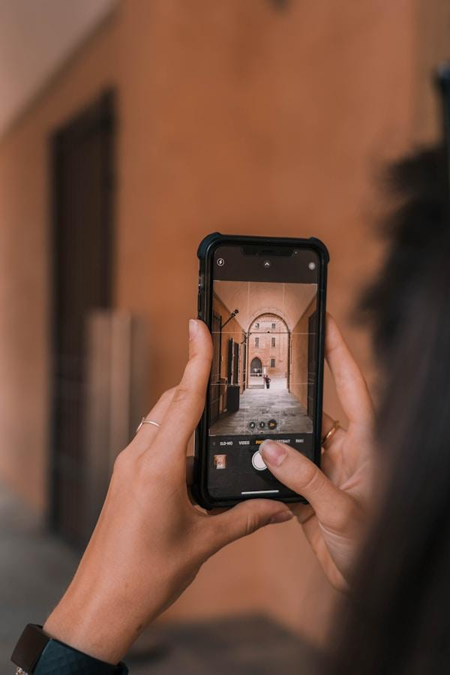

Slide 10
Links
List of recommended resources
Notes:
Photo Booth Rental Brea

Slide 11
Please visit :
target url
folder top
rss feed
folder articles
folder photos
folder pdfs
folder slides
photo
photo
photo
spreadsheet
spreadsheet key
spreadsheet pubhtml
spreadsheet pub
spreadsheet view
form
drawing
image
image link
document
document pub
document view
presentation
presentation pub
presentation view
presentation html

Slide 12
Videos
YouTube videos we recommend watching!
Notes:
Photo Booth Rental Brea

Slide 13

https://sites.google.com/view/brea-photo-booth-rental/home

Slide 14
https://sites.google.com/view/brea-photo-booth-rental/home

Slide 15

https://sites.google.com/view/brea-photo-booth-rental/home

Slide 16
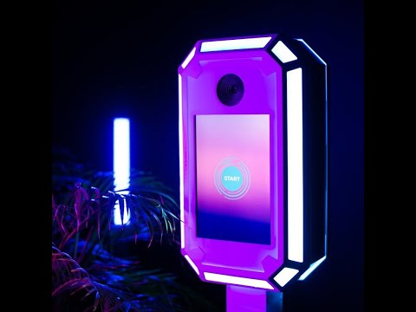
https://sites.google.com/view/brea-photo-booth-rental/home
Notes:
https://sites.google.com/view/brea-photo-booth-rental/home
https://drive.google.com/drive/folders/1CNlstsJzmPRpGDygZTjkJsPljmPP7HR7?usp=sharing
https://news.google.com/rss/search?q=photobooth+rental
https://drive.google.com/drive/folders/1THol6KdyQ5eRHDkuSNzpCCuA7W6G_06a?usp=sharing
https://drive.google.com/drive/folders/1qNjs32GLDqs_gyV7wvfqwQ0J0IbU7Eji?usp=sharing
https://drive.google.com/drive/folders/1LtInV3kl1GuLrtGtrQ7Gmty0iUOiqrW8?usp=sharing
https://drive.google.com/drive/folders/1nj2zzhbqP7alffxAB792eiMxJqQL9zRj?usp=sharing
https://drive.google.com/file/d/1M5yH2tZnwNNm8ymEjI8_SSZpgZtHNOAC/view?usp=sharing
https://drive.google.com/file/d/1wwDiQp1j2AiEPnUBtX86PsdkBuzqd4U7/view?usp=sharing
https://drive.google.com/file/d/1rjpPFpq1KLwNRQI5zUqq3p8Fb46TxuWh/view?usp=sharing
https://docs.google.com/spreadsheets/d/1eQSc2xaL9KH78-tqdSppxuOhVxSgCLxnUHtppYlS5V8/edit?usp=sharing
https://docs.google.com/spreadsheet/pub?key=1eQSc2xaL9KH78-tqdSppxuOhVxSgCLxnUHtppYlS5V8
https://docs.google.com/spreadsheets/d/1eQSc2xaL9KH78-tqdSppxuOhVxSgCLxnUHtppYlS5V8/pubhtml
https://docs.google.com/spreadsheets/d/1eQSc2xaL9KH78-tqdSppxuOhVxSgCLxnUHtppYlS5V8/pub
https://docs.google.com/spreadsheets/d/1eQSc2xaL9KH78-tqdSppxuOhVxSgCLxnUHtppYlS5V8/view
https://docs.google.com/forms/d/1v-Z3t2Yx3XfHh8V7DWZTwv99Di5dsjP59RcFFN8b8Ao/edit?usp=sharing
https://docs.google.com/drawings/d/1dNEp74shof81iozfyKaPZ8nPRPjle76vxNq3C4vsdTw/edit?usp=sharing
https://drive.google.com/file/d/1GYmOSOlo4yQ_pS_0YEV3H-FwZ_N3dFKh/view?usp=drivesdk
https://sites.google.com/view/culver-city-video-booth-rental/home
https://docs.google.com/document/d/1NLkSNiSEam89U1lib2N5PgHvaIfz8GTBImJ2aPJXoB4/edit?usp=sharing
https://docs.google.com/document/d/1NLkSNiSEam89U1lib2N5PgHvaIfz8GTBImJ2aPJXoB4/pub
https://docs.google.com/document/d/1NLkSNiSEam89U1lib2N5PgHvaIfz8GTBImJ2aPJXoB4/view
https://docs.google.com/presentation/d/1WXCmFum3W5g6BYVWYwcicoNxeAq5DHnEomLNUNiEm9g/edit?usp=sharing
https://docs.google.com/presentation/d/1WXCmFum3W5g6BYVWYwcicoNxeAq5DHnEomLNUNiEm9g/pub?start=true&loop=true&delayms=3000
https://docs.google.com/presentation/d/1WXCmFum3W5g6BYVWYwcicoNxeAq5DHnEomLNUNiEm9g/view
https://docs.google.com/presentation/d/1WXCmFum3W5g6BYVWYwcicoNxeAq5DHnEomLNUNiEm9g/htmlpresent

Slide 17
Photo Booth Rental Brea
https://sites.google.com/view/brea-photo-booth-rental/home
Notes:
Photo Booth Rental Brea

